Slide 1
CISC3003 Individual project
Online shopping-cart system
DC12790 Alex Chen Zirui

Slide 2
OVERVIEW
What is a Chart Shop.
List of services.
Test-run

Slide 3
What is My system about?
This Cart Shop is a online e-commerce shopping website
List of services:
Add products.
Products view.
Add products to cart.
Buy products and check orders.
Remove products in cart.

Slide 4
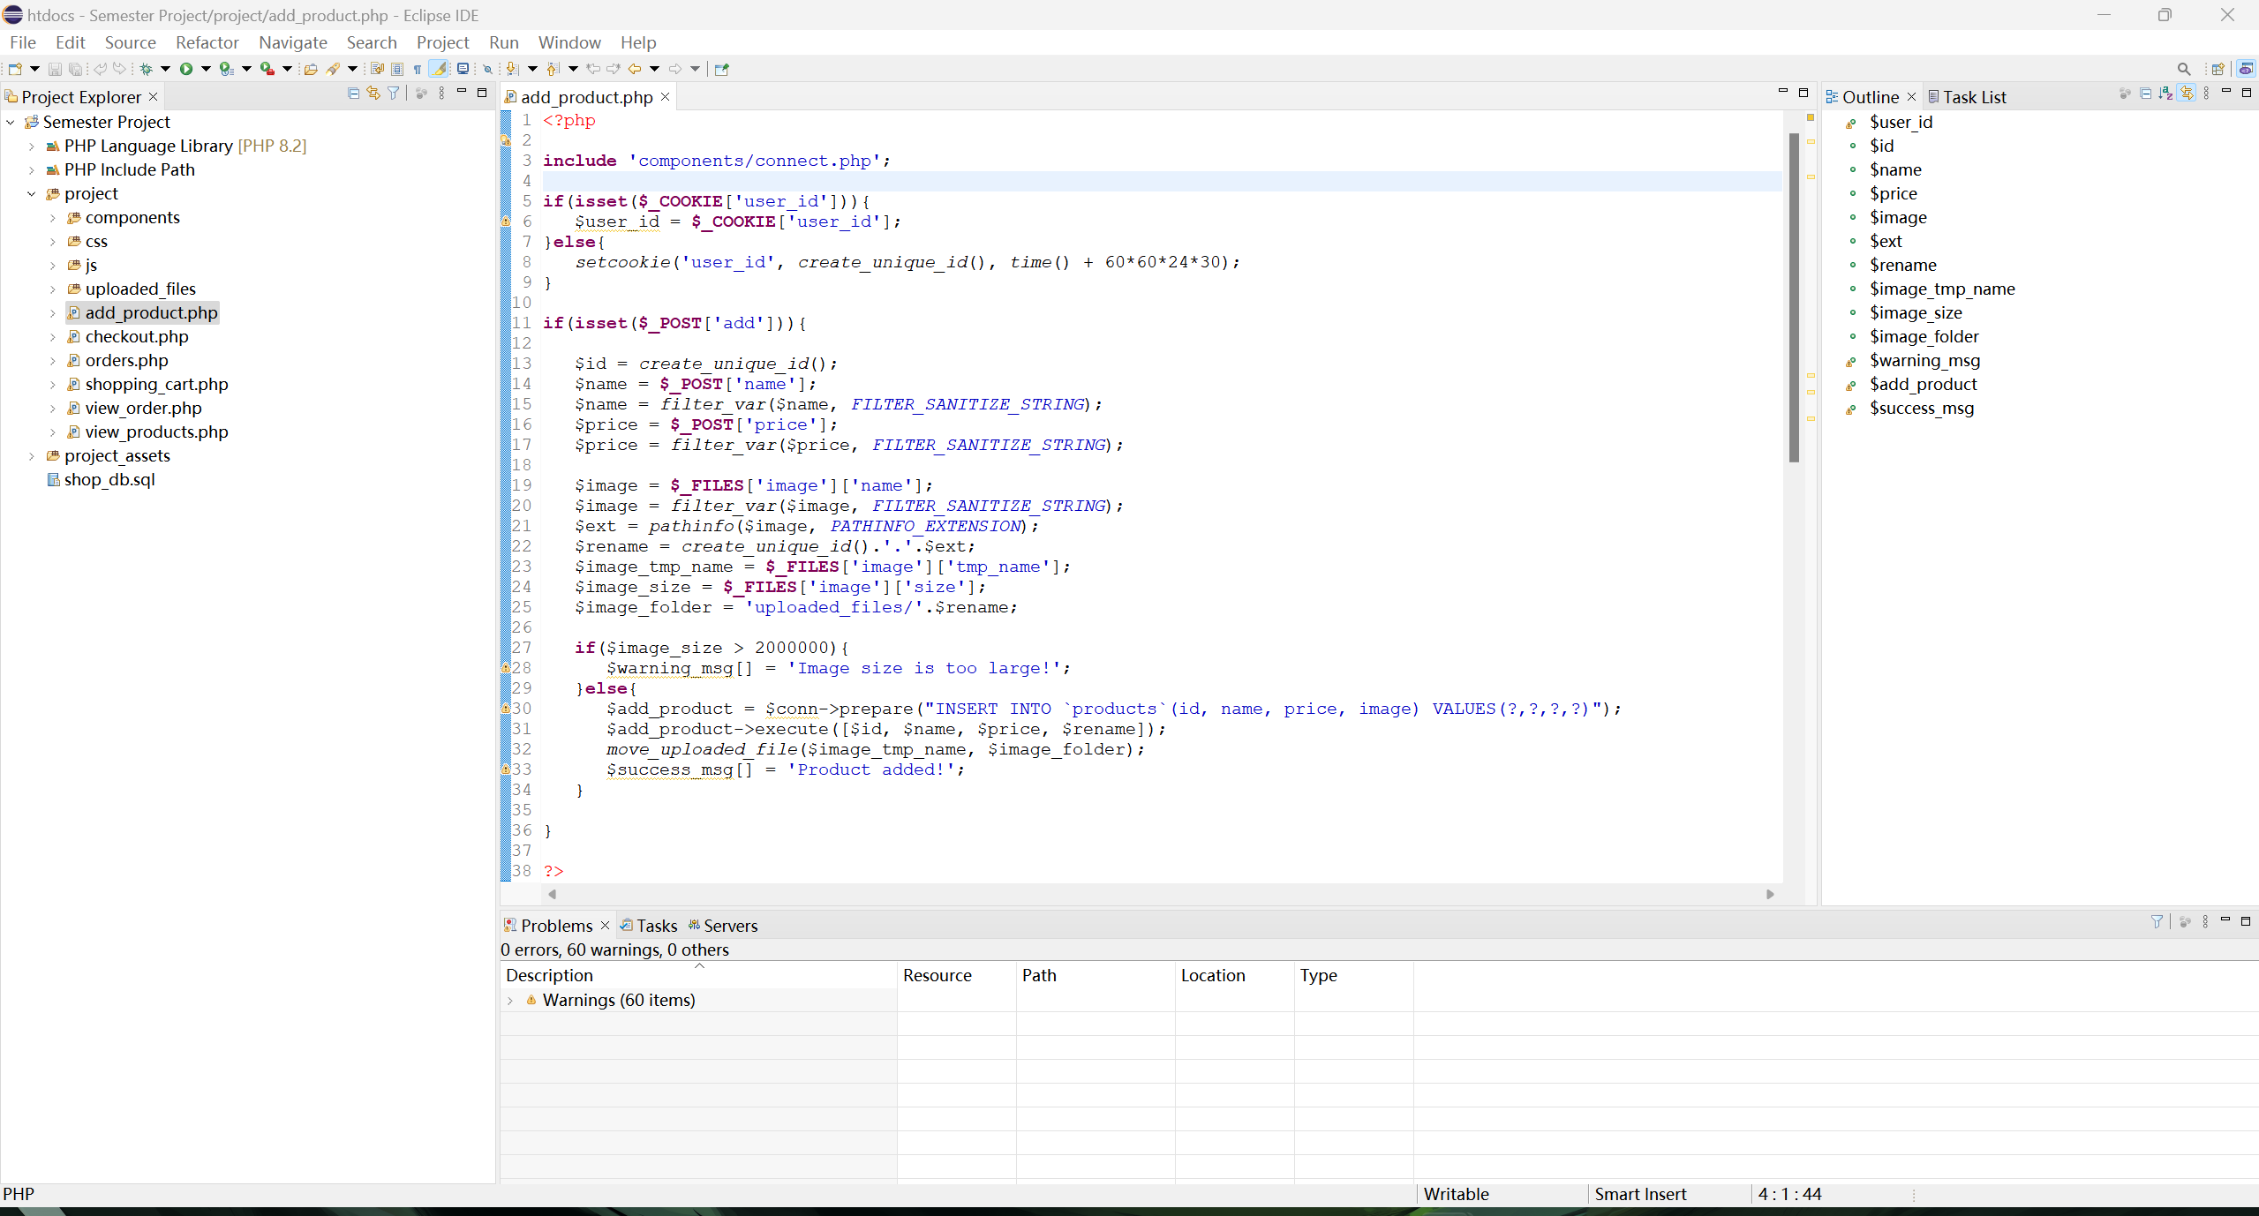
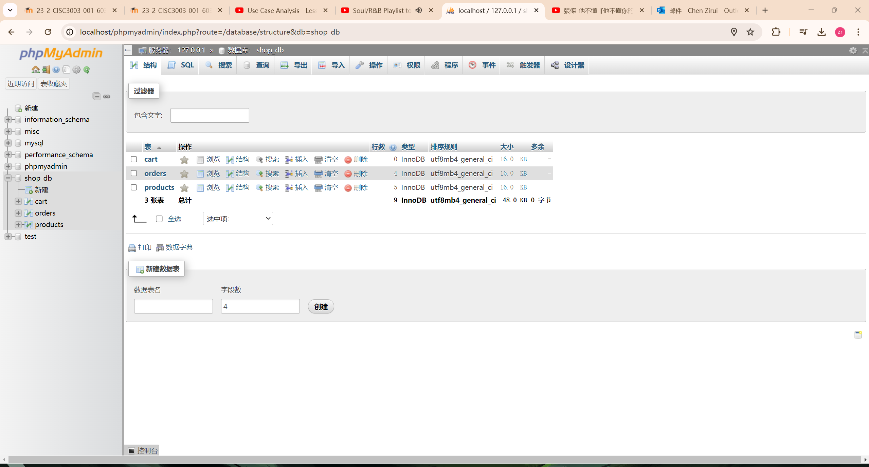
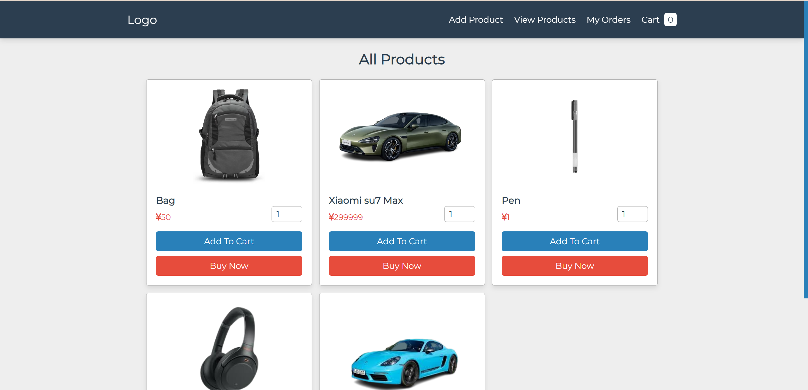
Frontend
HTML, CSS, JS, PHP
Backend
XAMPP
database
SQL
Website view

Slide 5
Services introduction
Add products.
Products view.
Add products to cart.
Remove products in cart.
Buy products and check orders.

Slide 6
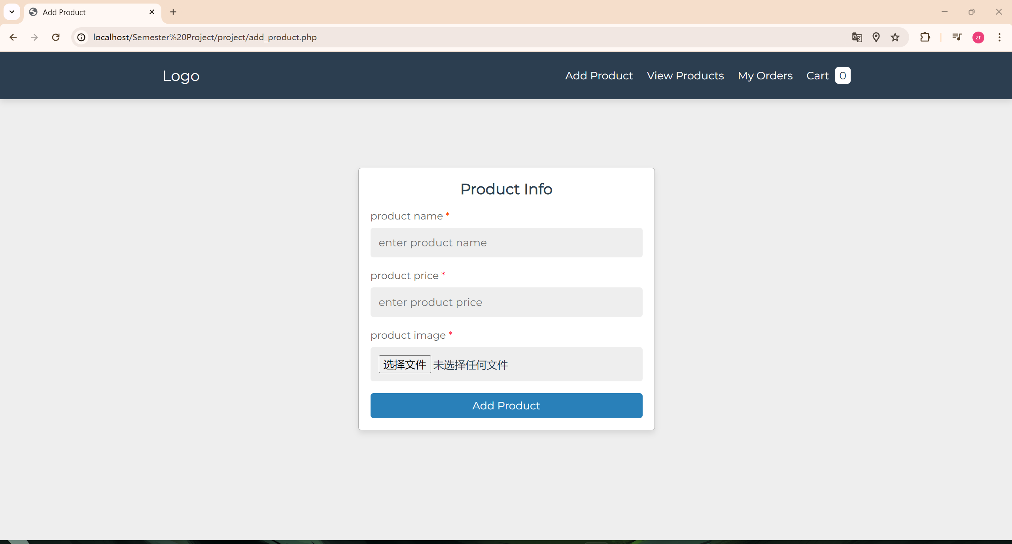
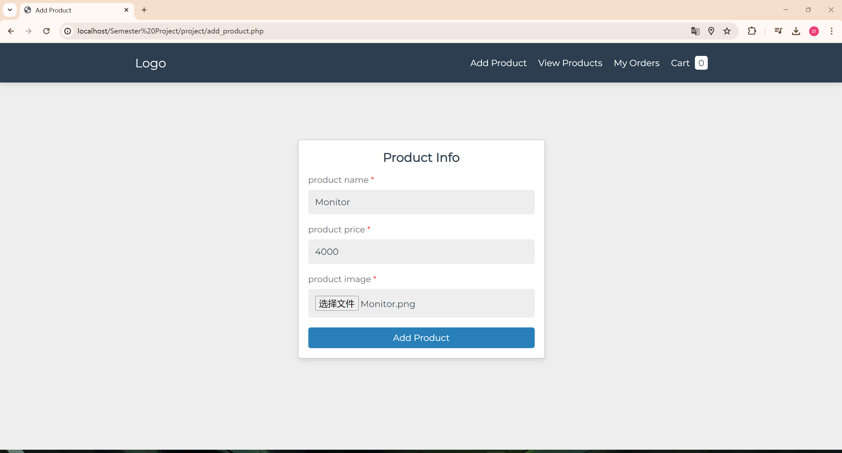
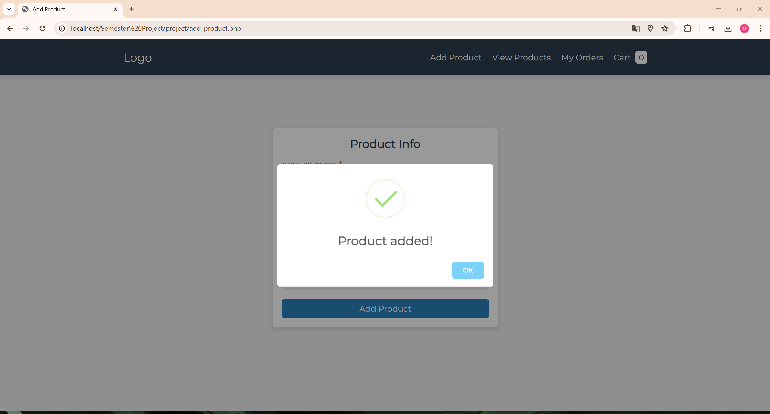
ADD PRODUCTS

Slide 7
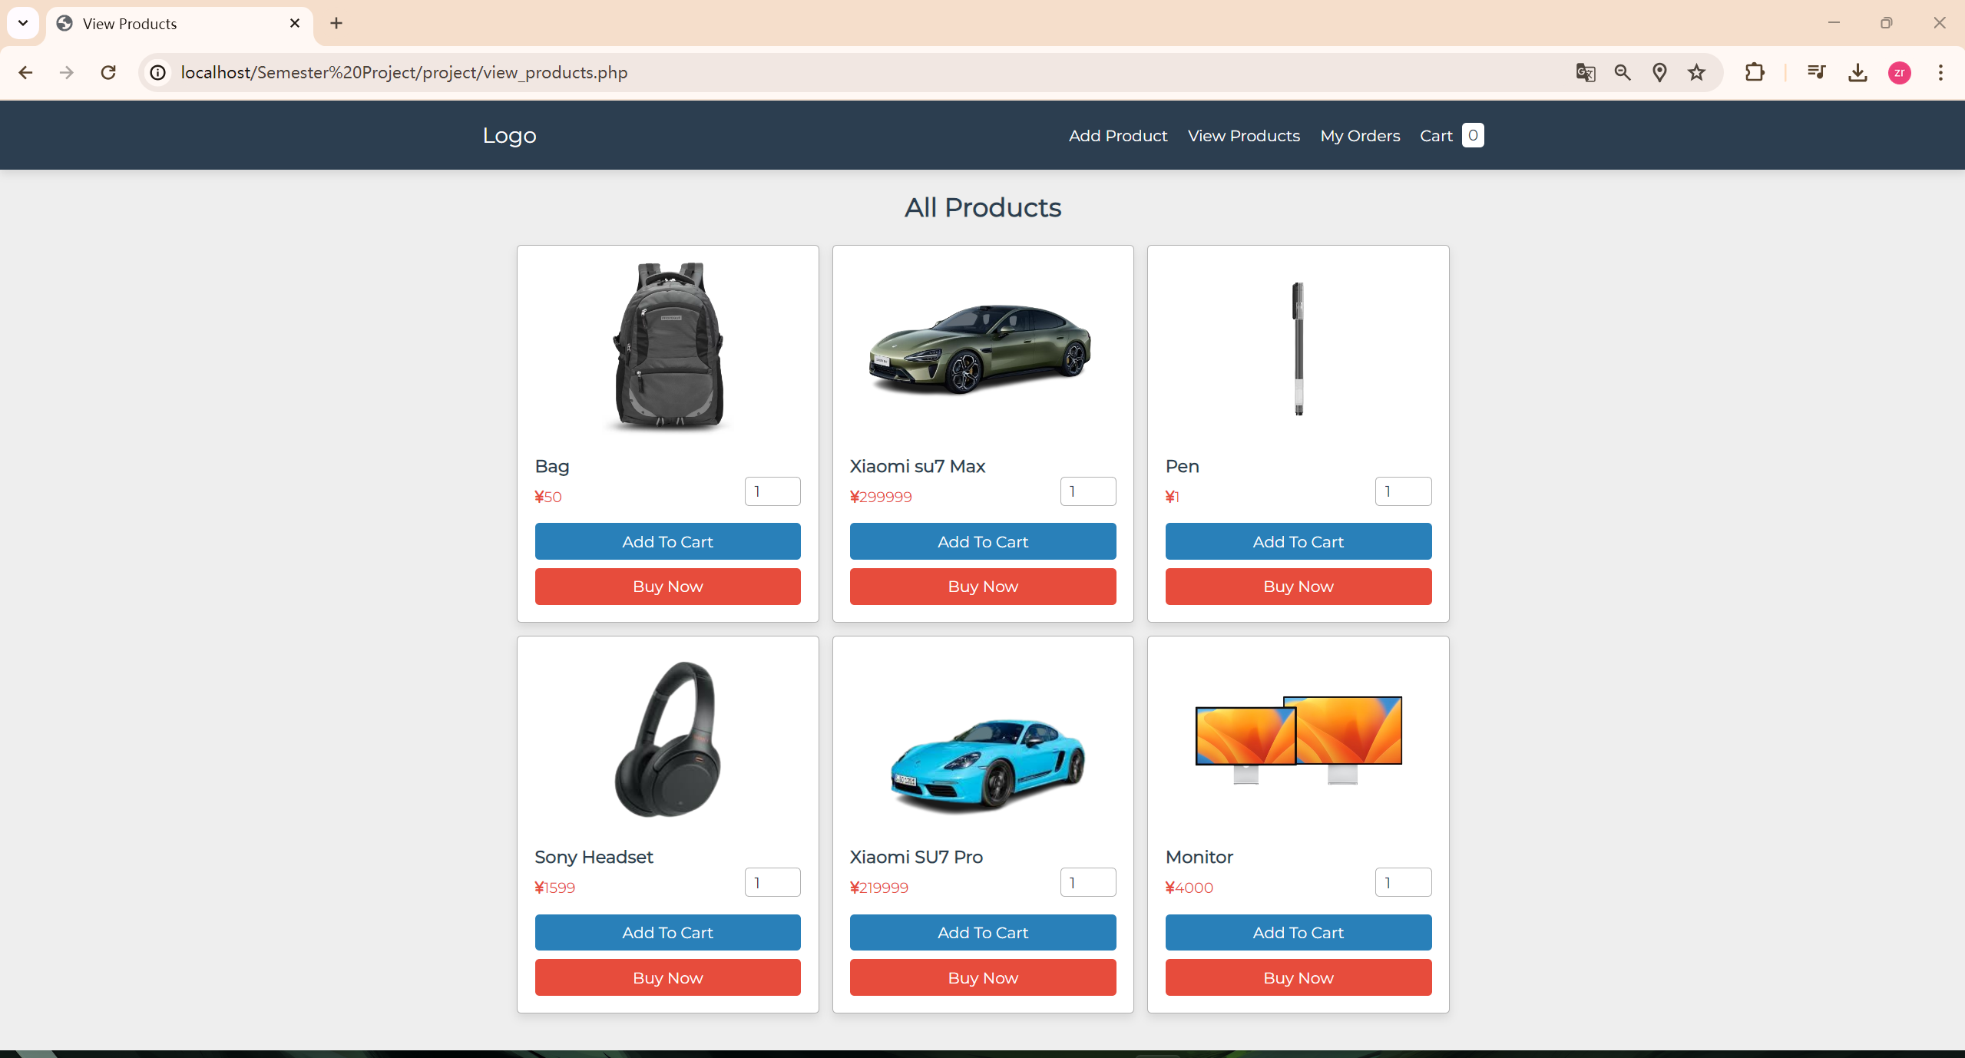
PRODUCTS view

Slide 8
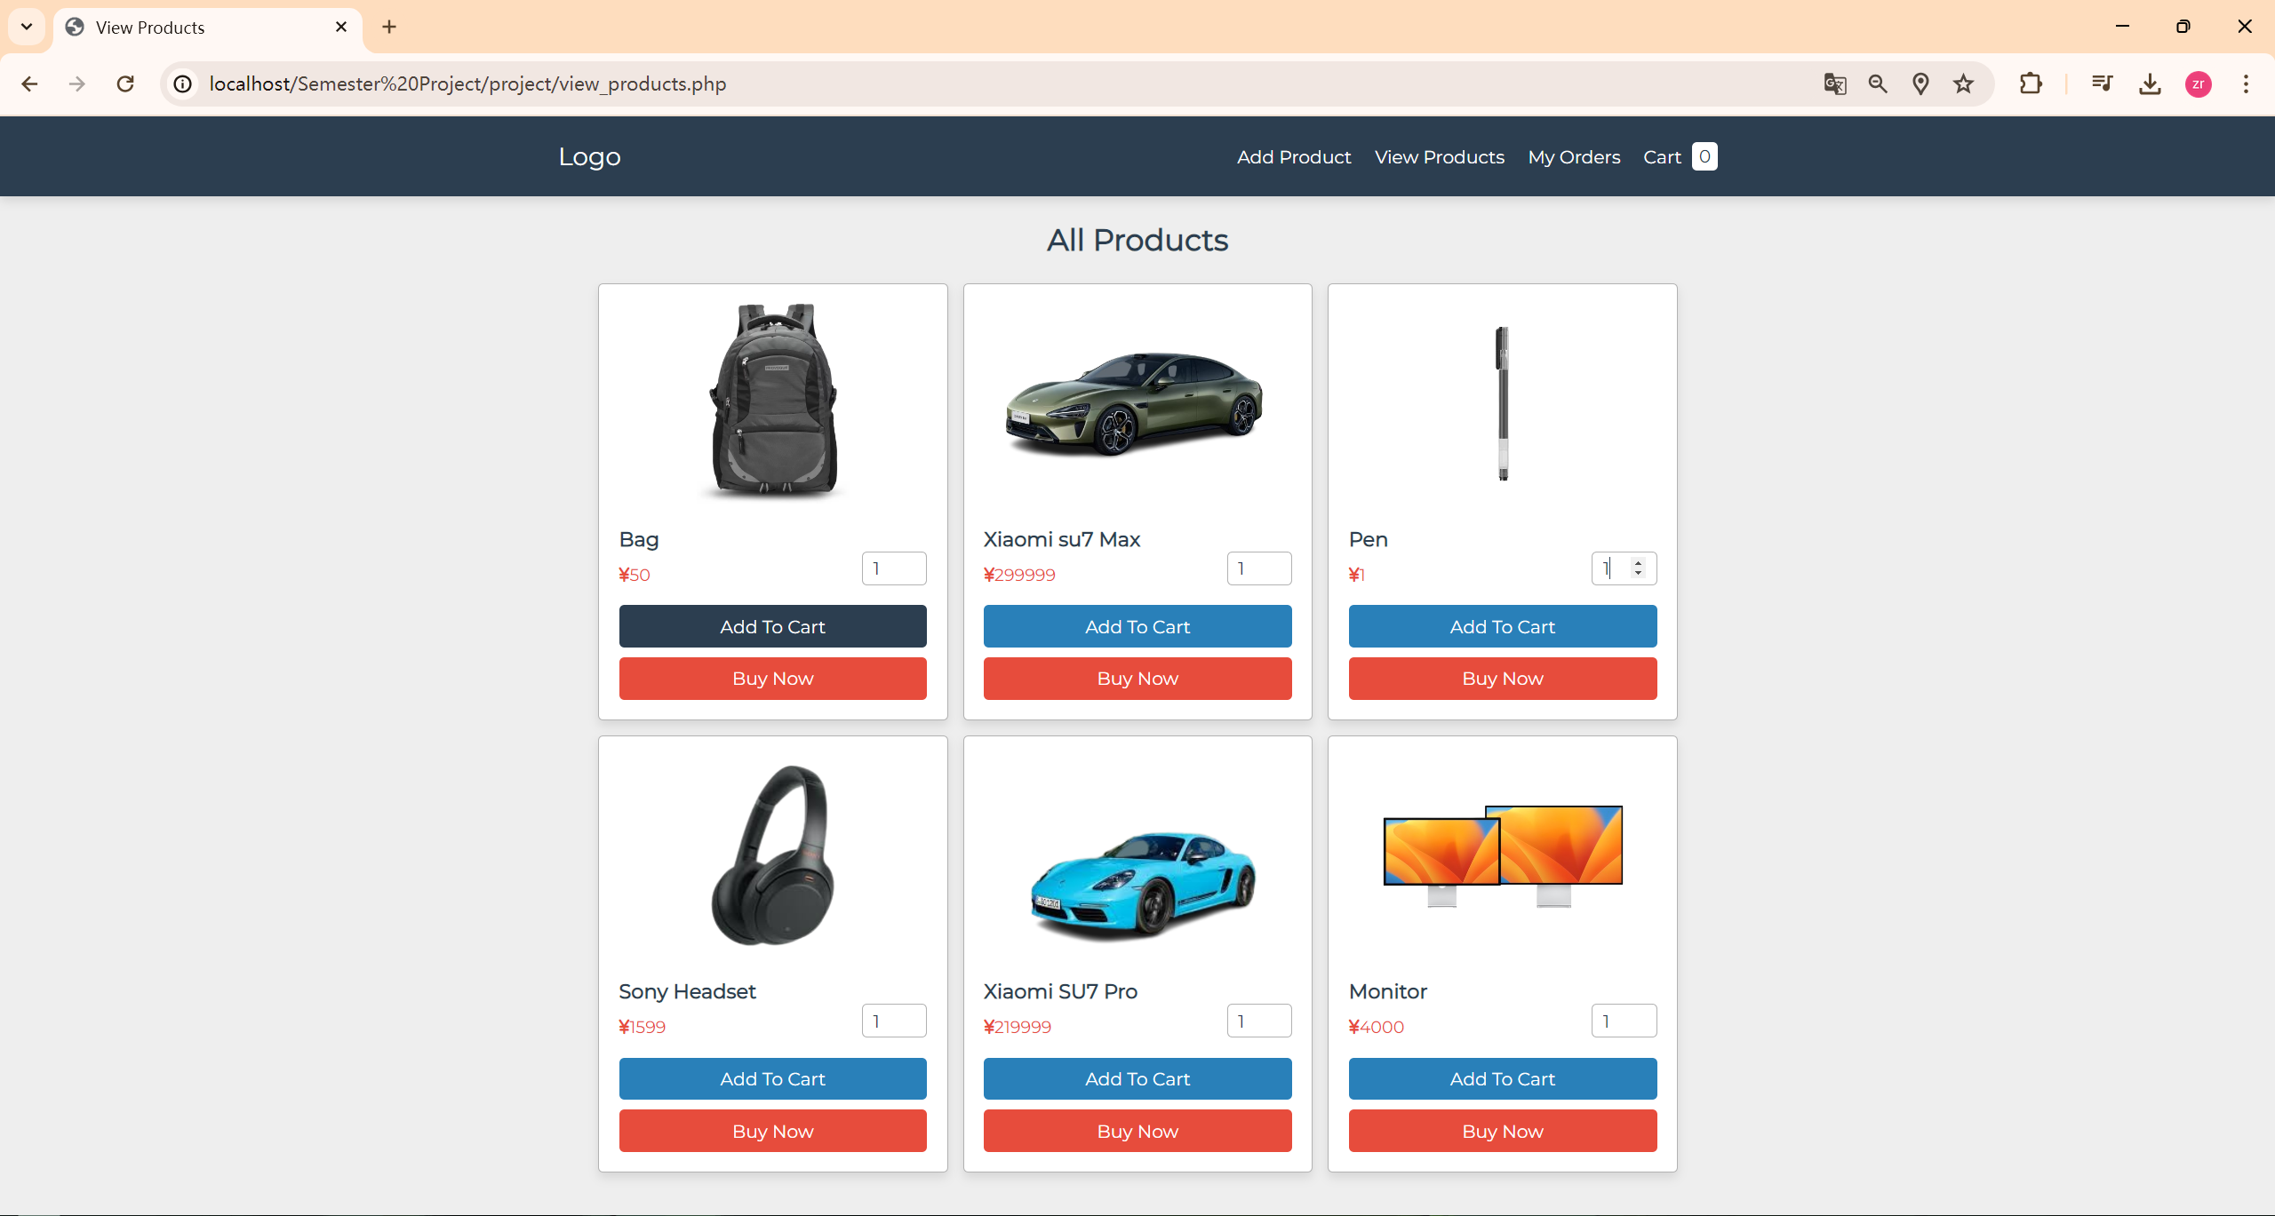
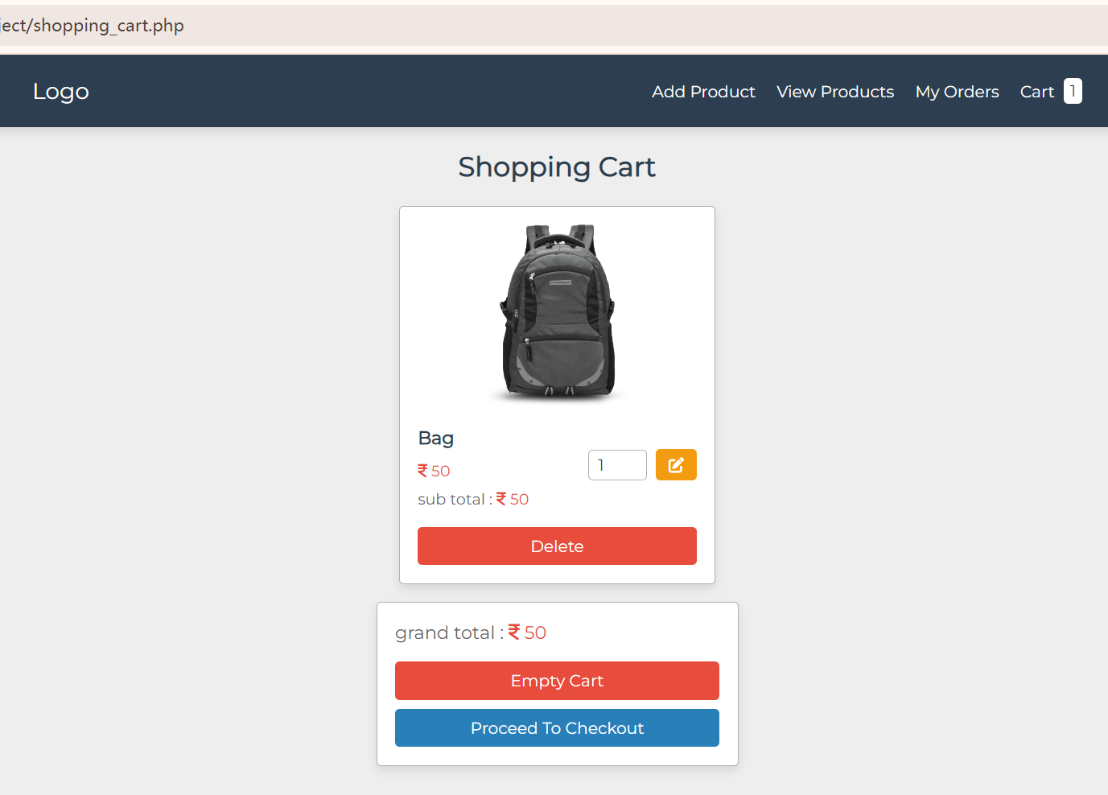
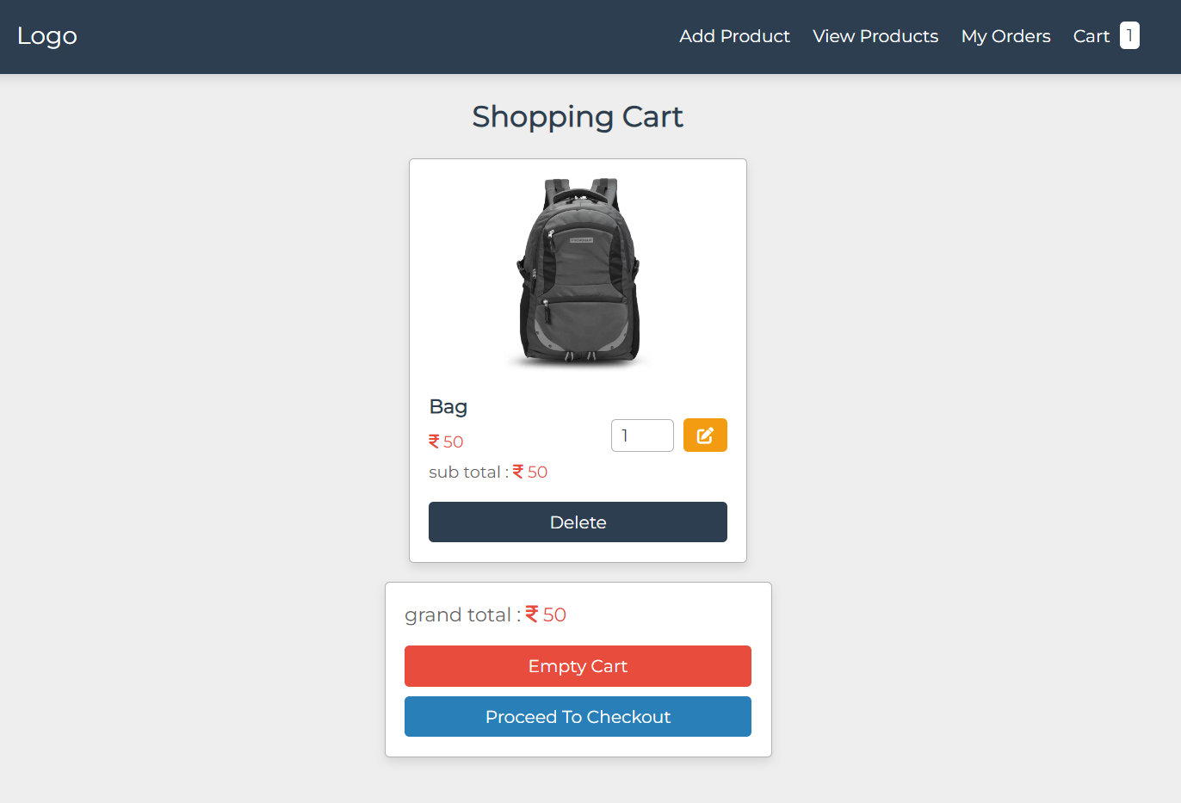
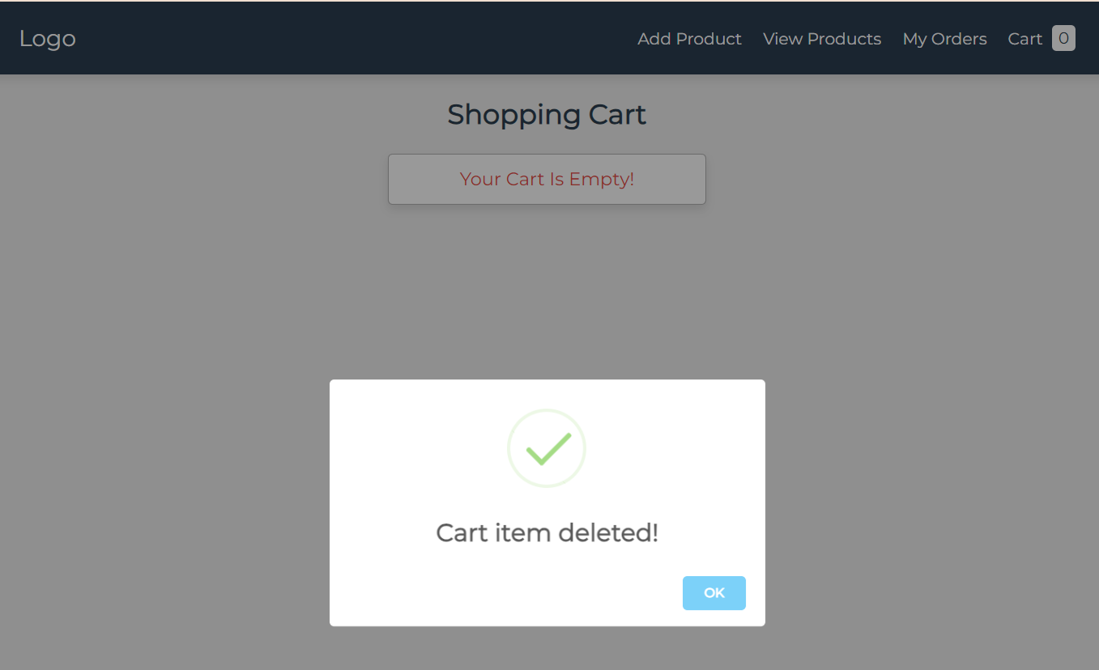
Add & remove products into cart

Slide 9
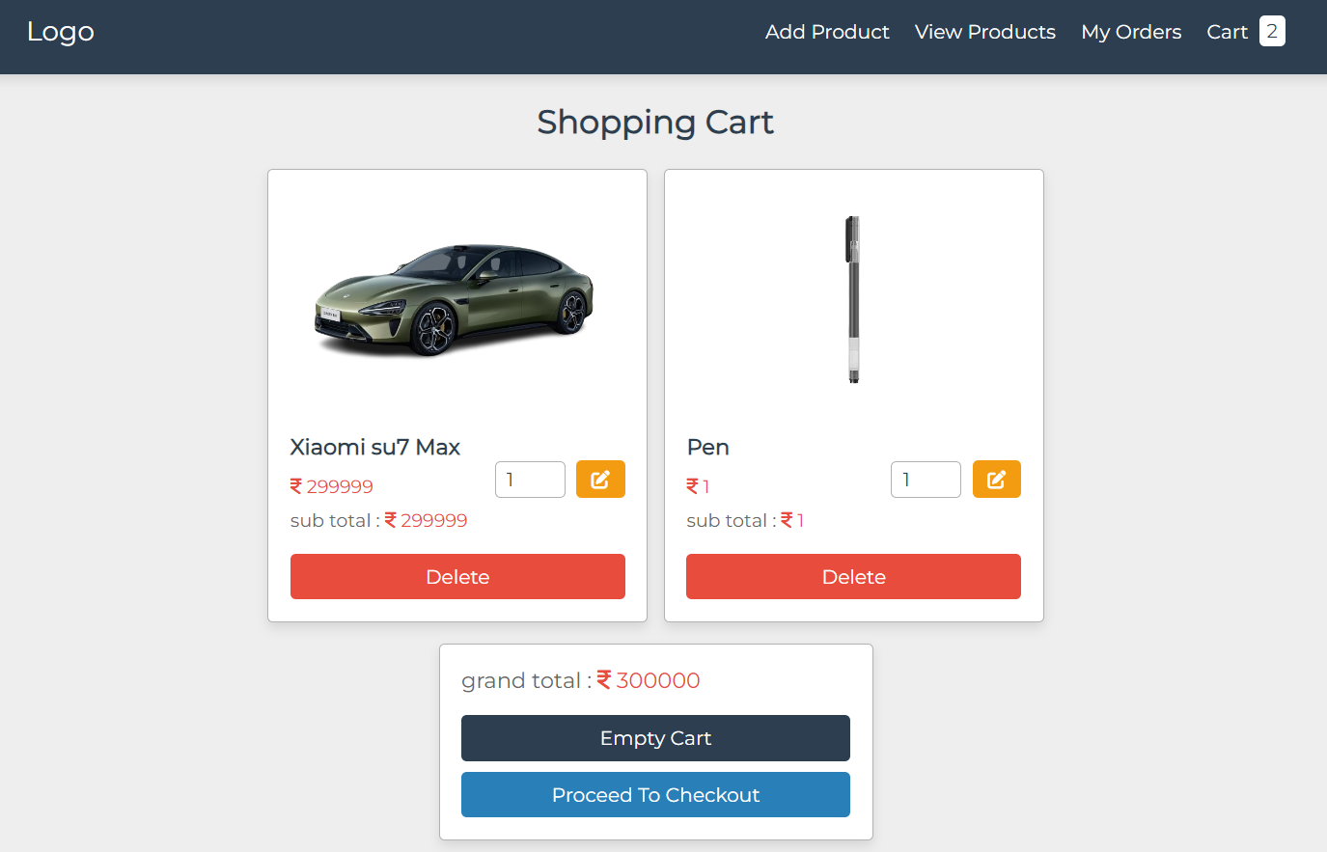
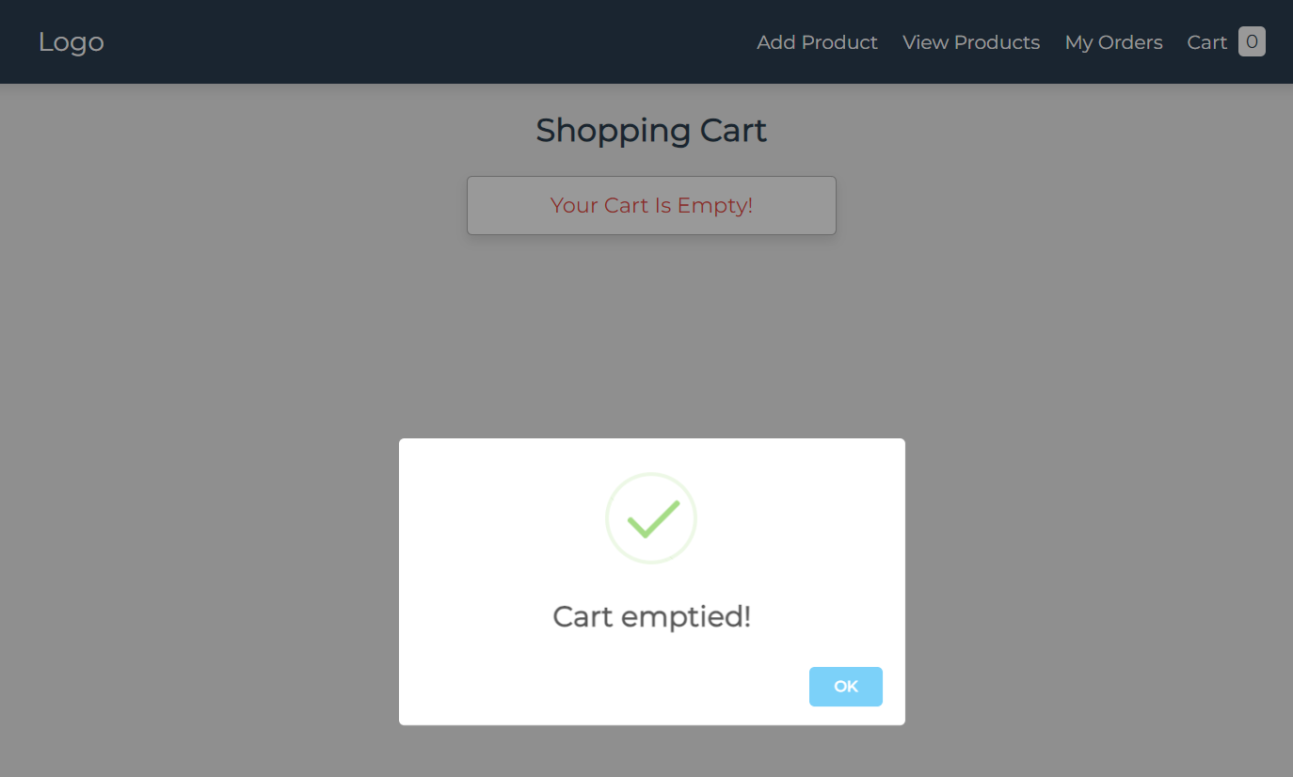
Products remove: Empty cart

Slide 10
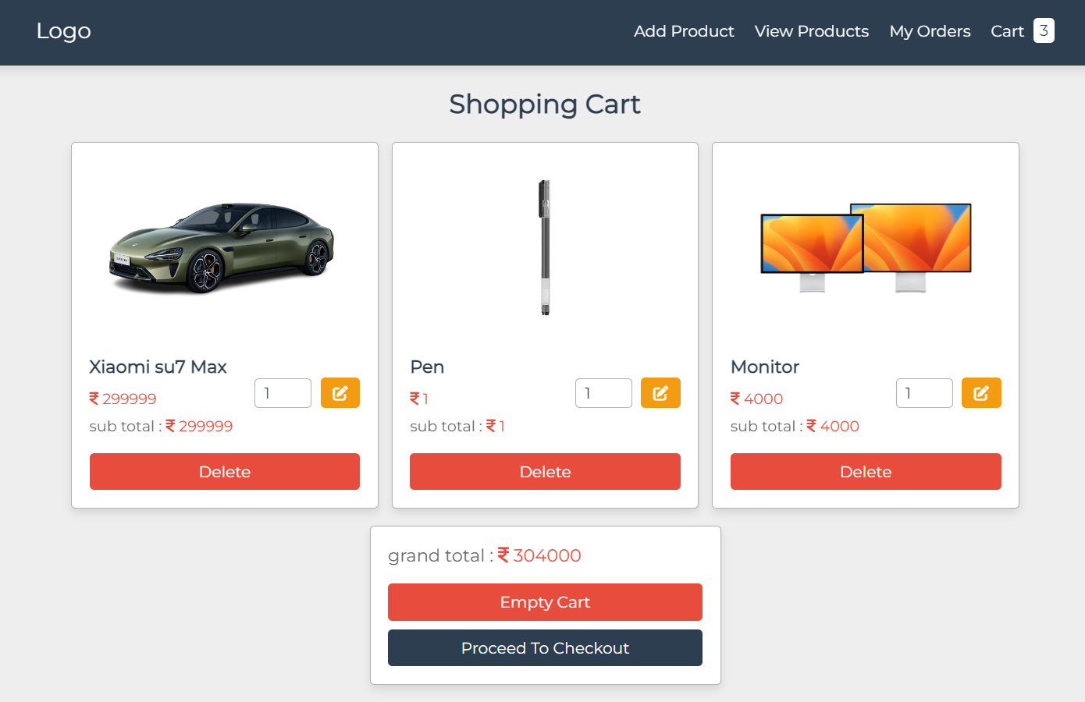
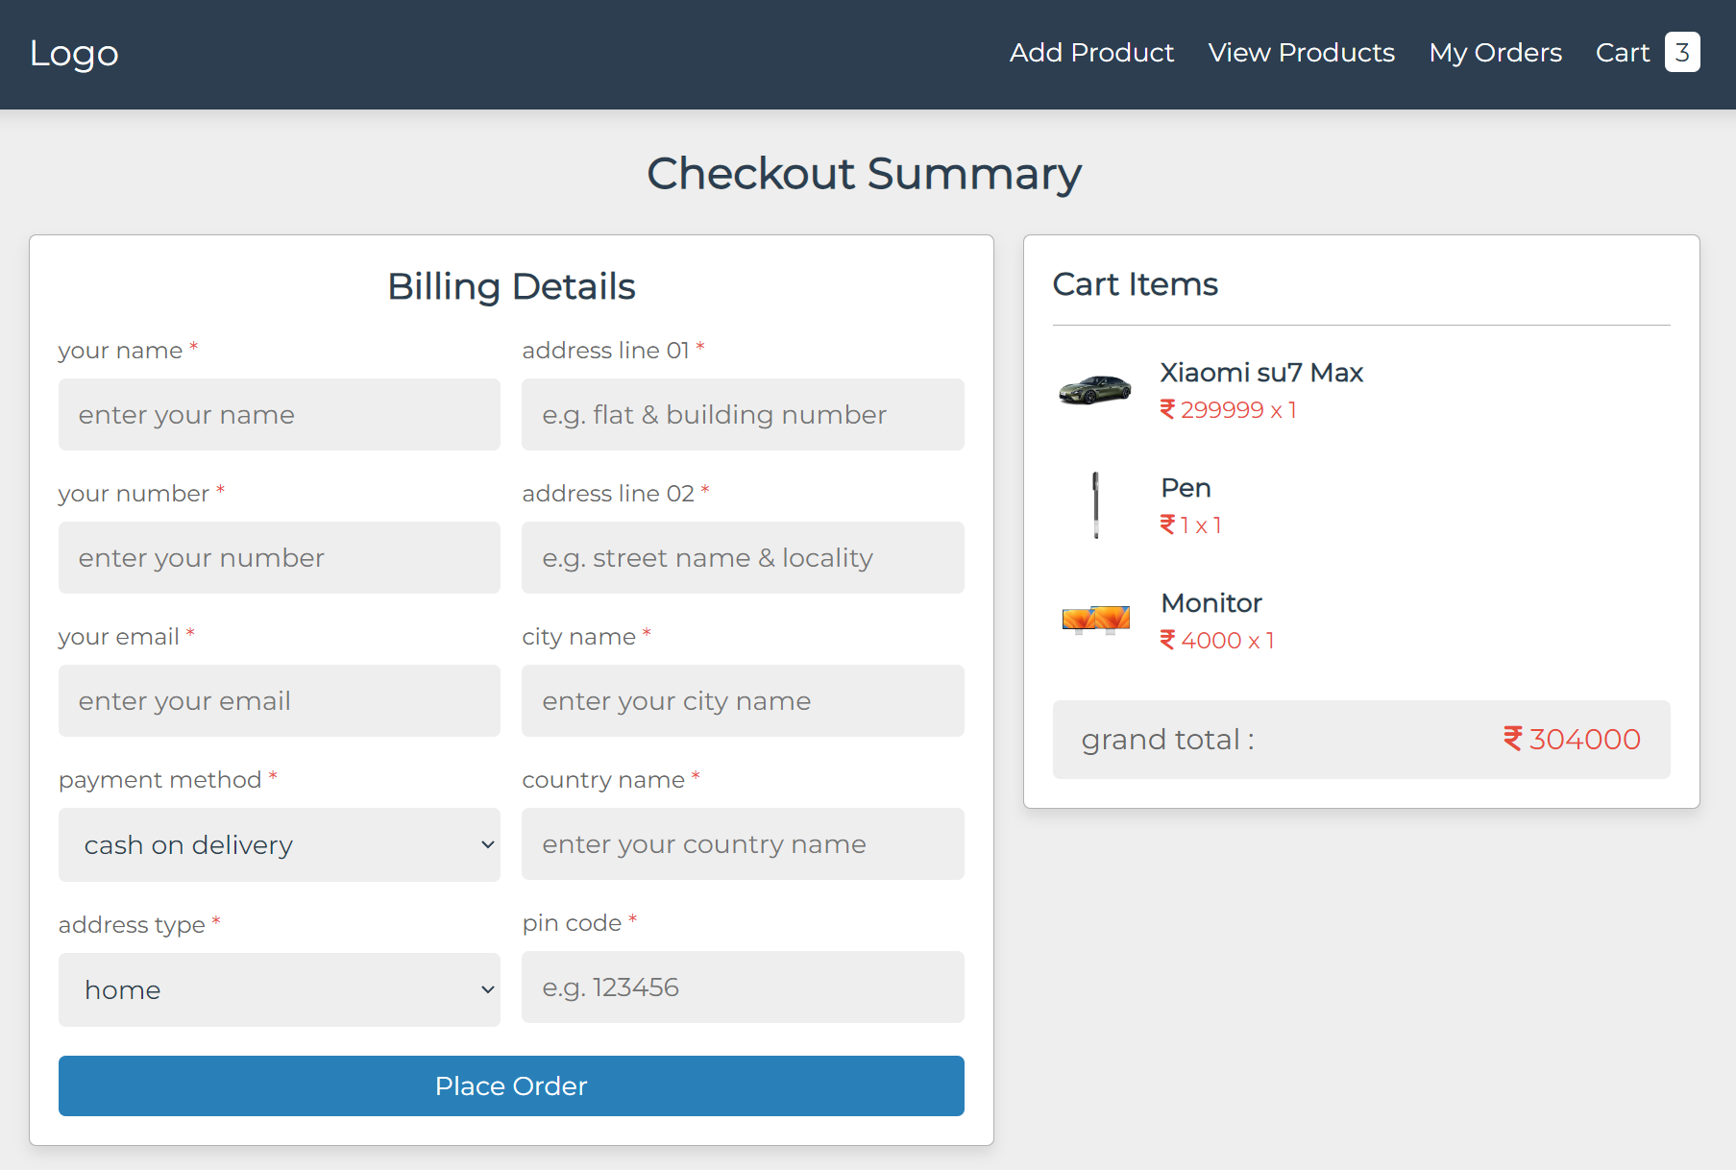
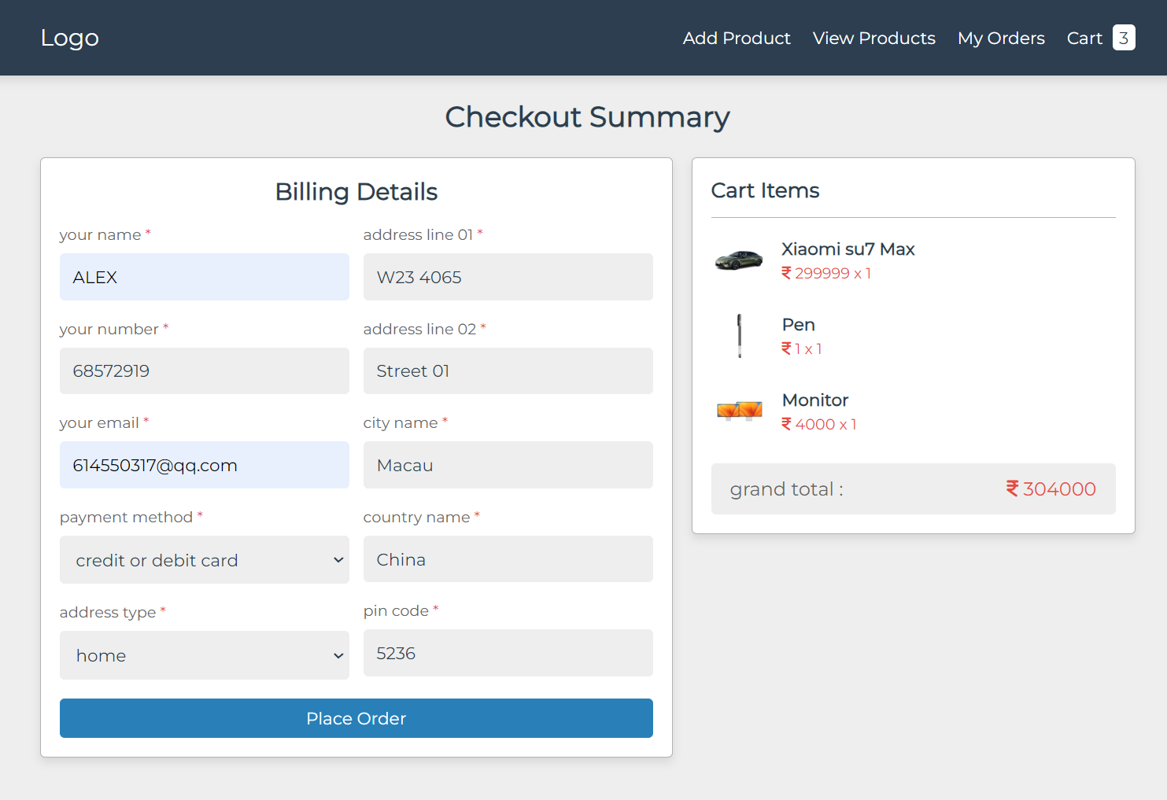
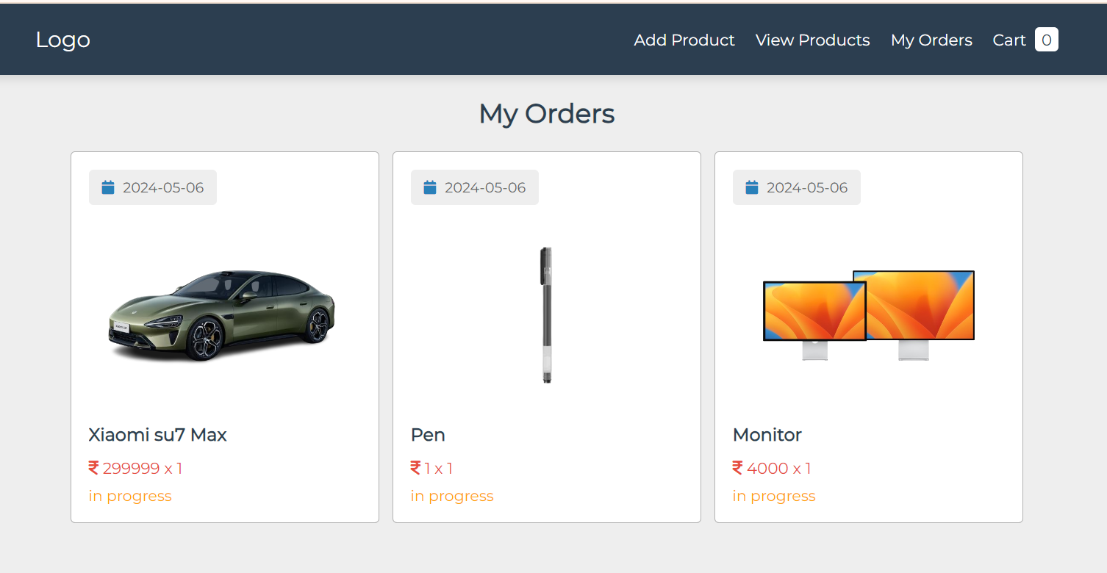
Buy products

Slide 11
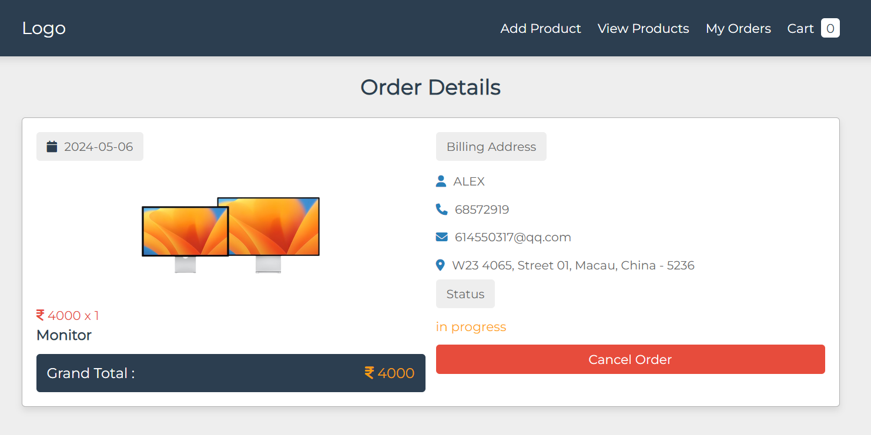
Buy products

Slide 12
Techniques introduction
Front-End
Back-End
Database

Slide 13
conclusion
Online shopping-cart system is a online shopping system which applied with full-stack web development technology.
2. In this system ,we provide services:
a. Add products.
b. Products view.
c. Add products to cart.
d. Buy products and check orders.
e. Remove products in cart.
3.However, this system didn’t have user login system, this is another function need to be finish.

Slide 14
Thaks for listening!!!

